Slide 1
Programming for Machine Learning Scala or Python : A comparative review
Presented by
Ranjana Seshadri

Slide 2
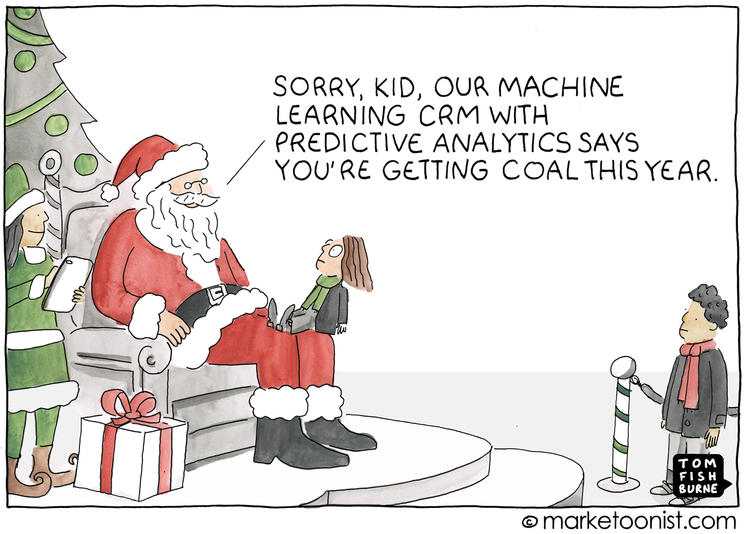
Machine Learning
Notes:
How presentation will benefit audience: Adult learners are more interested in a subject if they know how or why it is important to them.
Presenter’s level of expertise in the subject: Briefly state your credentials in this area, or explain why participants should listen to you.

Slide 3
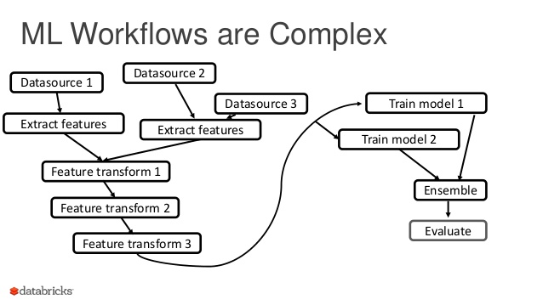
Machine Learning And Programming Languages
ML workflow is complex
High computational demands
Multiple Parallelisms
This brings out many interesting issues in the tools we use to create them – that is, programming languages.
Notes:
How presentation will benefit audience: Adult learners are more interested in a subject if they know how or why it is important to them.
Presenter’s level of expertise in the subject: Briefly state your credentials in this area, or explain why participants should listen to you.

Slide 4
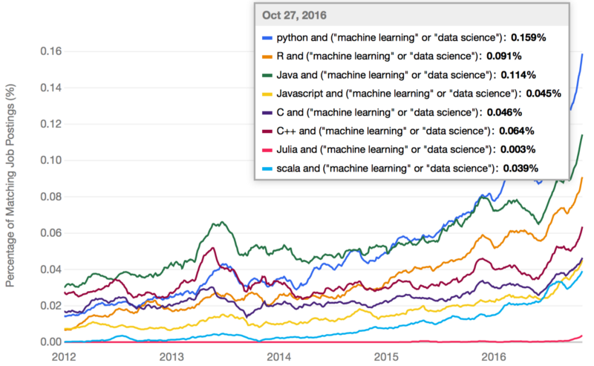

Slide 5
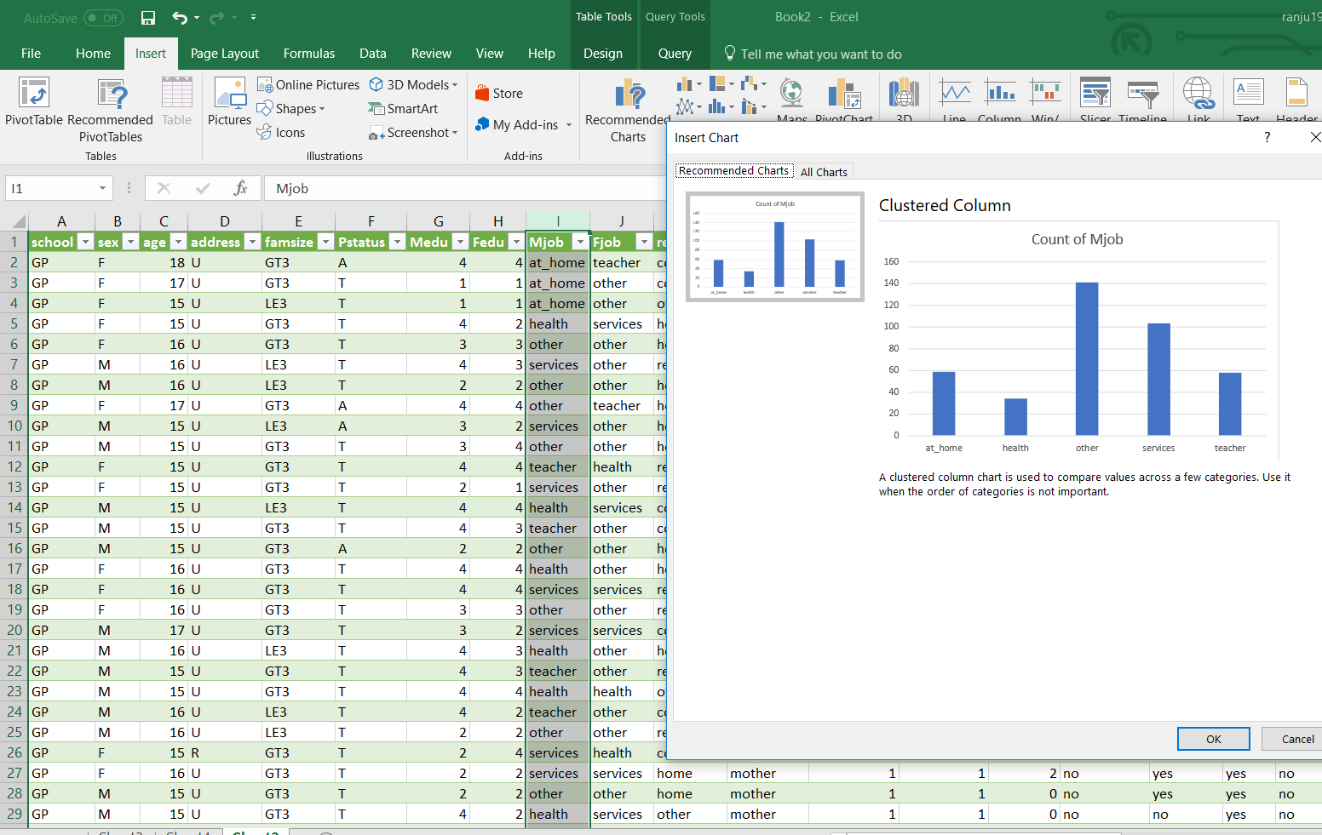

Slide 6
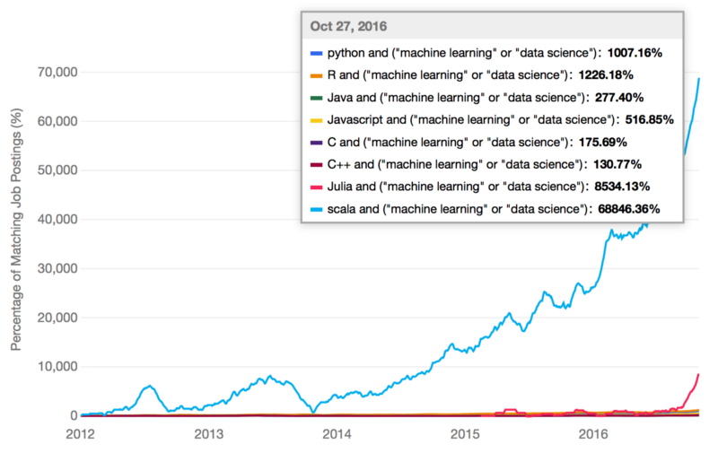

Slide 7
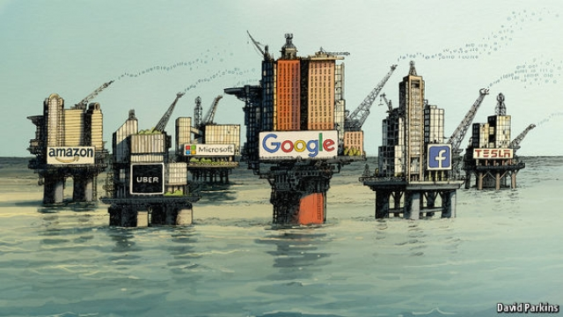
Scalable Machine Learning And Big Data
“The world’s most valuable resource is no longer oil, but DATA “
Unlike traditional analysis, machine learning thrives on growing datasets.
Apache Mahout
Apache Spark
R-Hadoop
Notes:
Lesson descriptions should be brief.

Slide 8
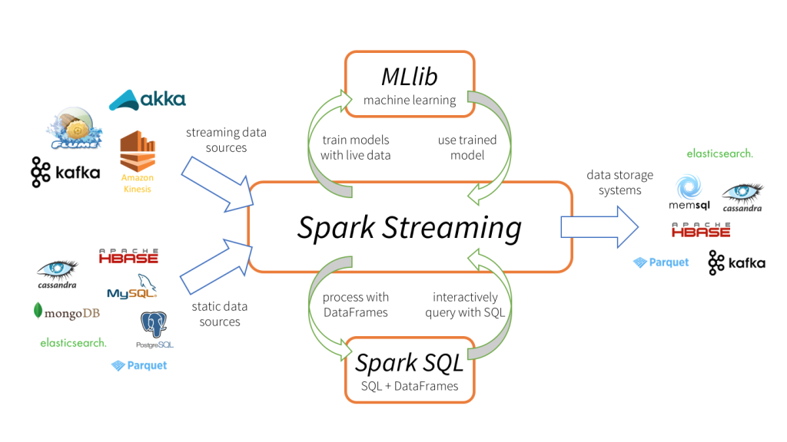
Apache Spark
Clustered computing framework
Fast
Easy to use
Spark’s MLlib
Scalable
Supports Python , Scala ,Java
Pipelines ,Persistence,Utilities,ML Algorithms,Statistic Packages

Slide 9



VS
 | PYTHON | SCALA
Performance
Productivity And Ease of User
Simplicity
Concurrency and Parallelism
Type Safety
Scalability
Visualization
Apache Spark

Slide 10
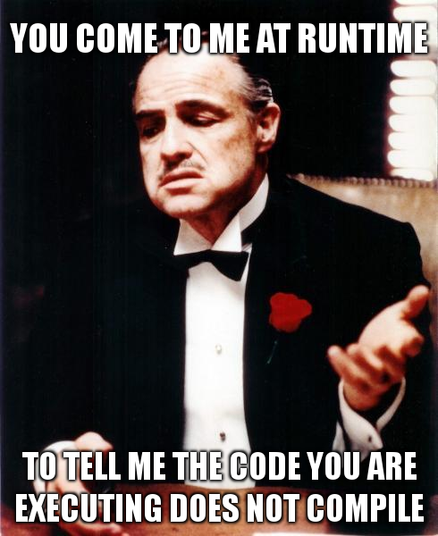
Features
Python | Scala
Dynamically Typed | Statically Typed
Difficult to Refactor | Easy Refactoring
Less Verbose | More Verbose
Lot of Libraries | Less Libraries
Huge Community Support | Less Community Support

Slide 11
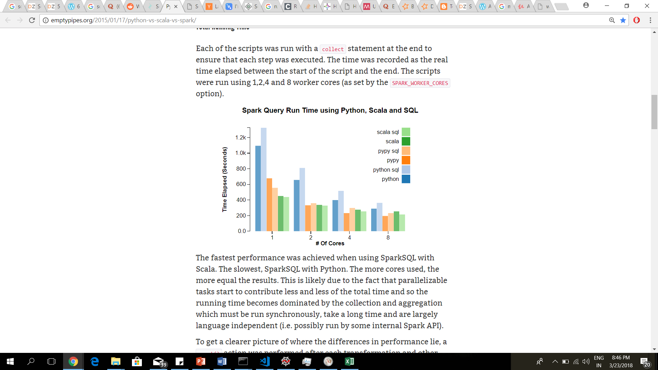
Performance
Scala is faster as it runs on JVM
Apache Spark -Python wrapper calls the underlying Spark codes written in Scala

Slide 12
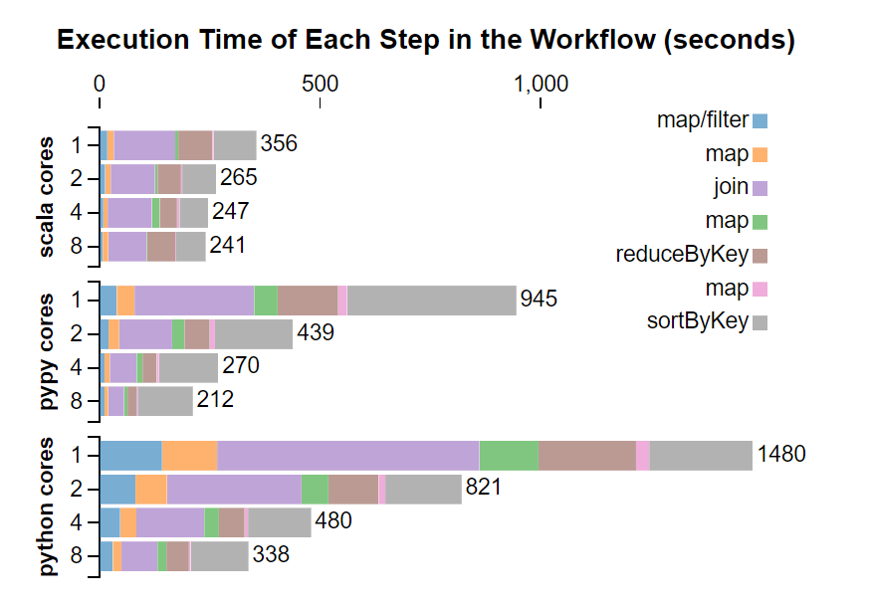
Task
Load a table and convert string to integers (map, filter)
Load another table, parse dates and convert to integers (map)
Join the two tables on a key (join)
Rearrange the keys and values (map)
Count the number of occurrences of a key (reduceByKey)
Rearrange the keys and values (map)
Sort by key (sortByKey)

Slide 13
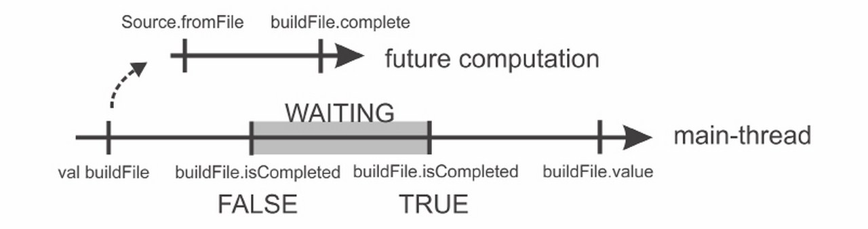
Concurrency And Parallelism
PYTHON | SCALA
Pythons GIL runs only one thread at a time | Parallel Collections
Use of Multiprocessor Library: I/O overhead | Future and Promises
 | Actors-Akka
Future

Slide 14
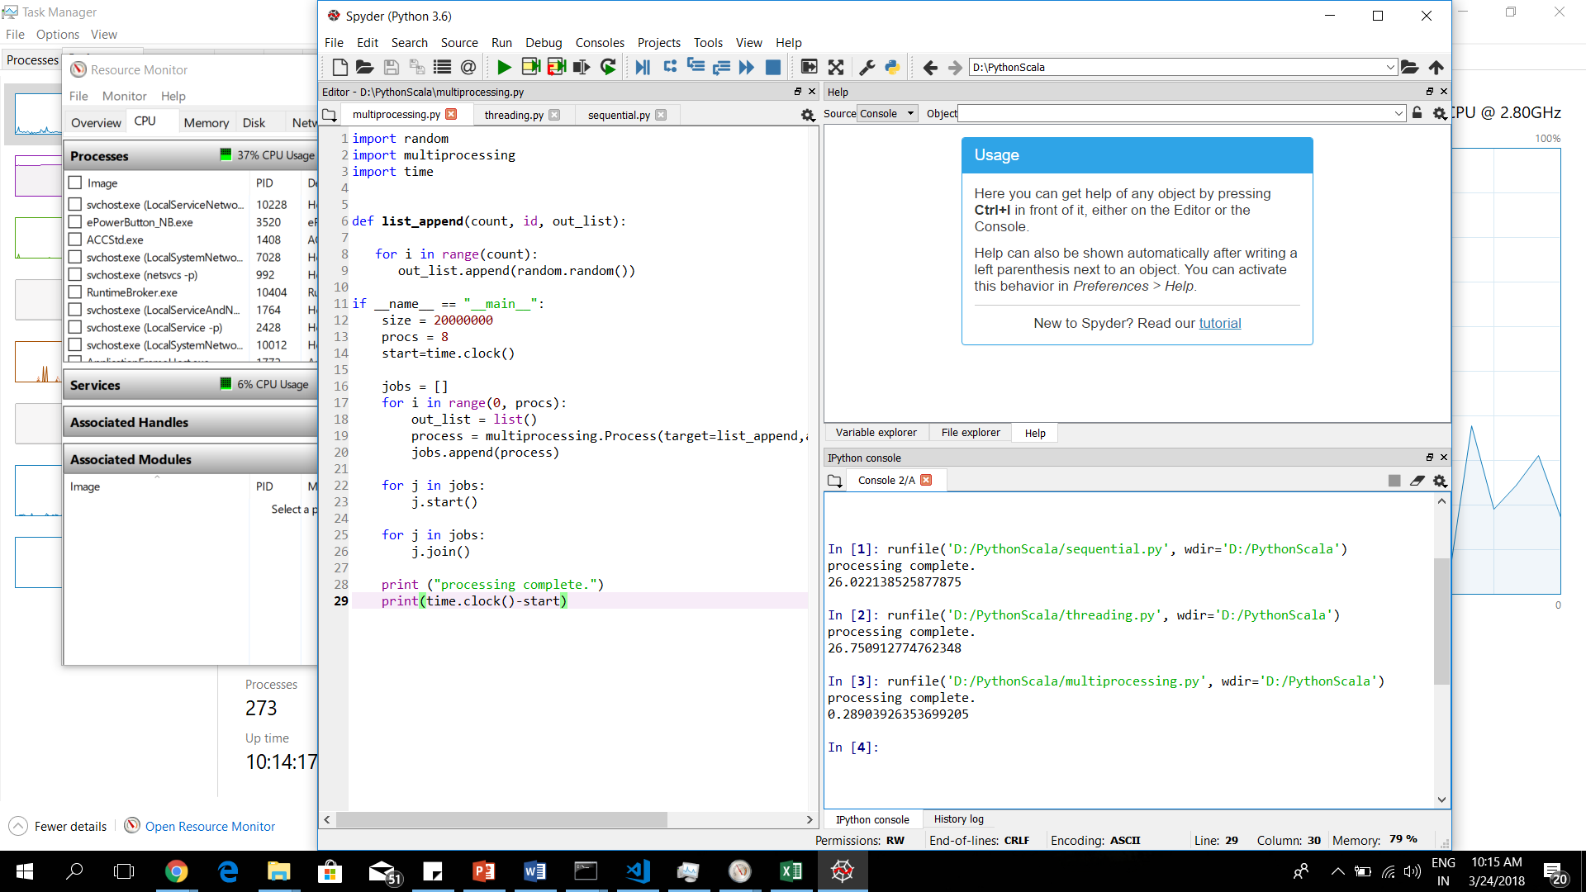
Sequential Processing Vs Threading Vs Multiprocessing

Slide 15
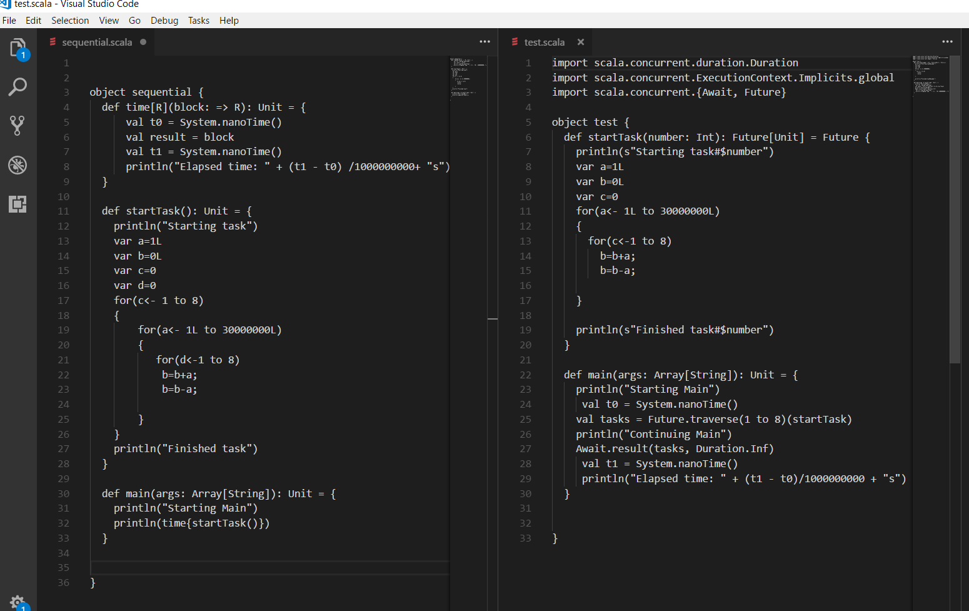

Slide 16
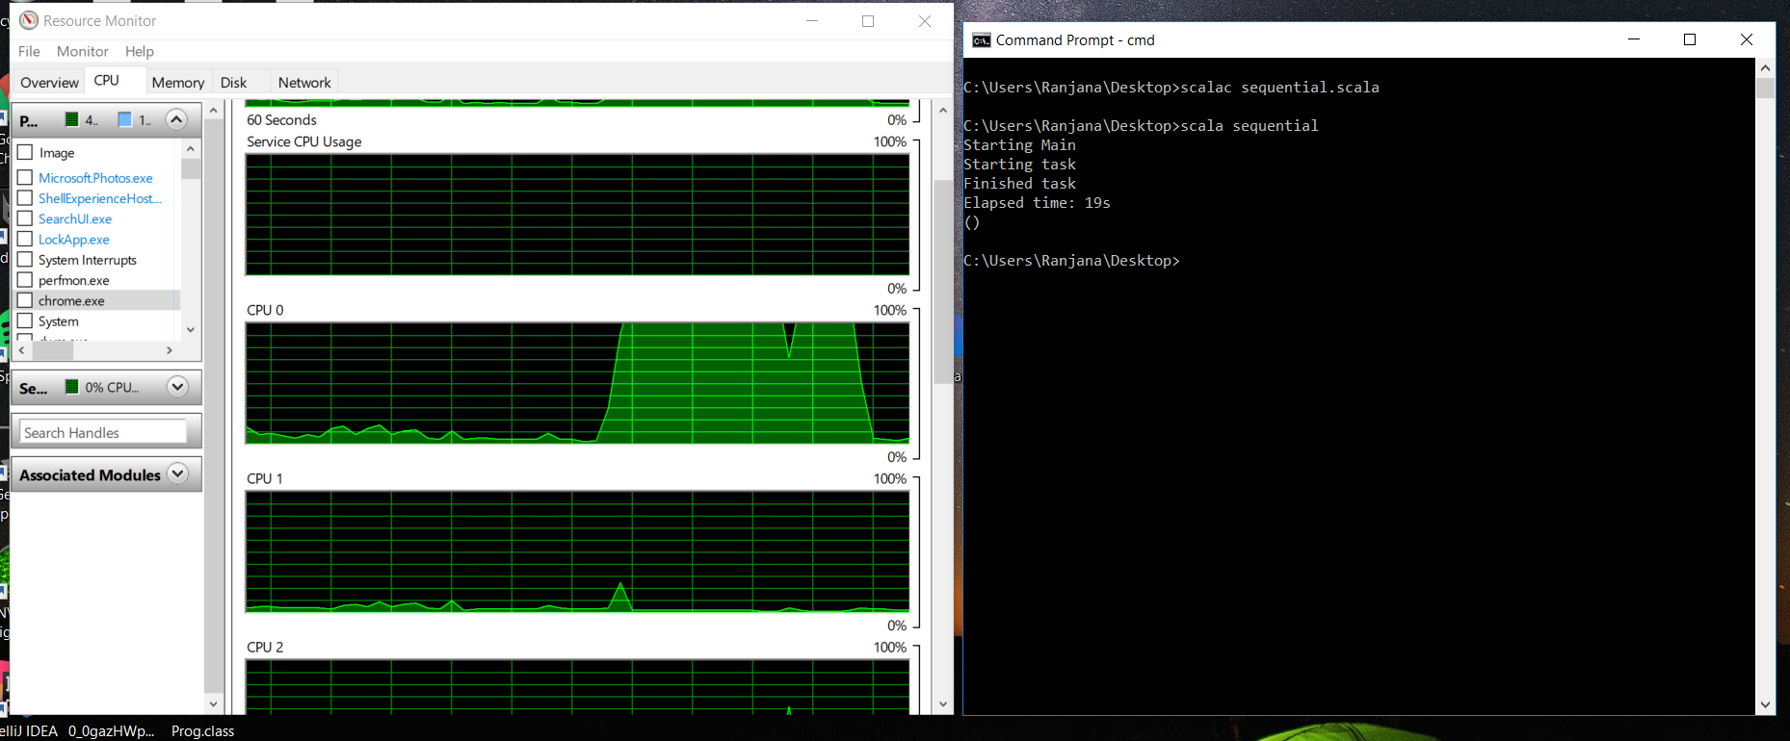
Sequential Execution

Slide 17
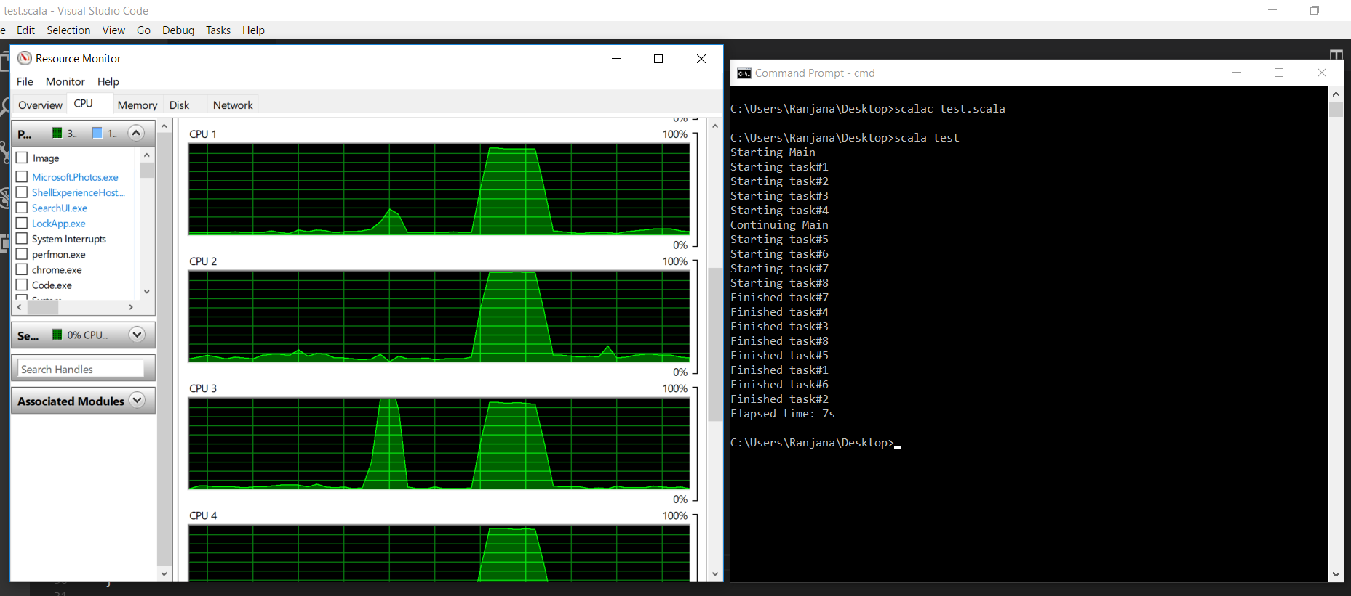
Parallel Execution

Slide 18
Visualization
Python | Scala
Extensive Libraries | Less Visualization Libraries
MatPlotLib | Breeze
Plotly | Vegas
Bokeh
Seaborn

Slide 19
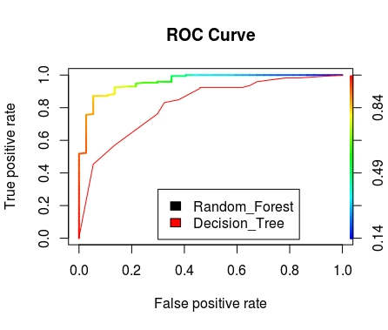
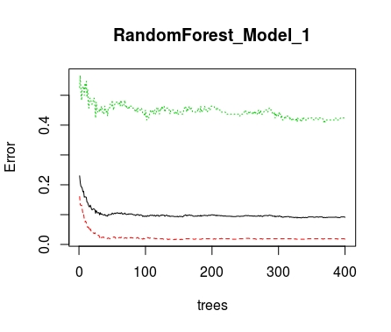
Visualization in R

Slide 20
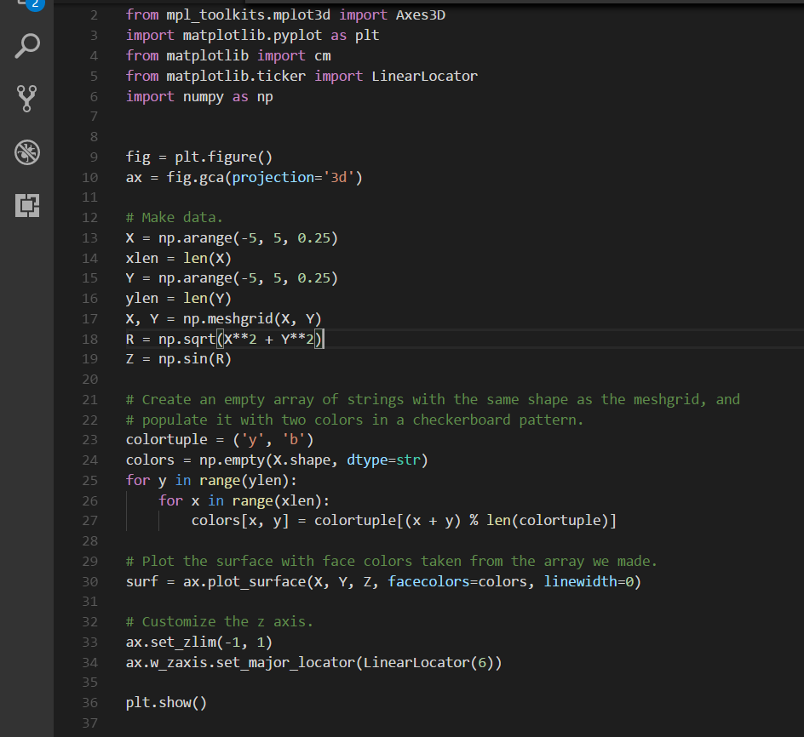
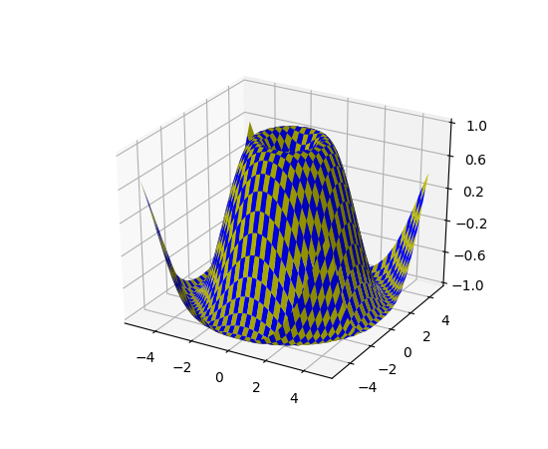
Visualization in python

Slide 21



Slide 22
Thankyou ☺

